Slide 1

Real-Time Face Detection & Face Recognition Workflows
Advanced Computer Vision Pipeline Implementation
Date: 26 October 2023 | Presenter: Moaz Salem

Slide 2

What is Face Detection & Recognition?
Face Detection: Locating faces within an image or video stream. It identifies facial regions with bounding boxes.
Face Recognition: Identifying specific individuals. It matches detected faces to a database of known identities.
Detection is the first step, followed by recognition. Both are crucial for various real-world applications.

Slide 3






System Architecture Overview
Our system processes visual input through several key stages, from initial capture to final identification. This pipeline ensures efficient and accurate facial analysis.
Camera Input
Real-time video stream acquisition.
Pre-processing
Image enhancement and noise reduction.
Detection
Identifying and localising faces.
Feature Extraction
Generating unique facial embeddings.
Recognition
Matching embeddings to a database.
Output
Displaying results and actions.

Slide 4
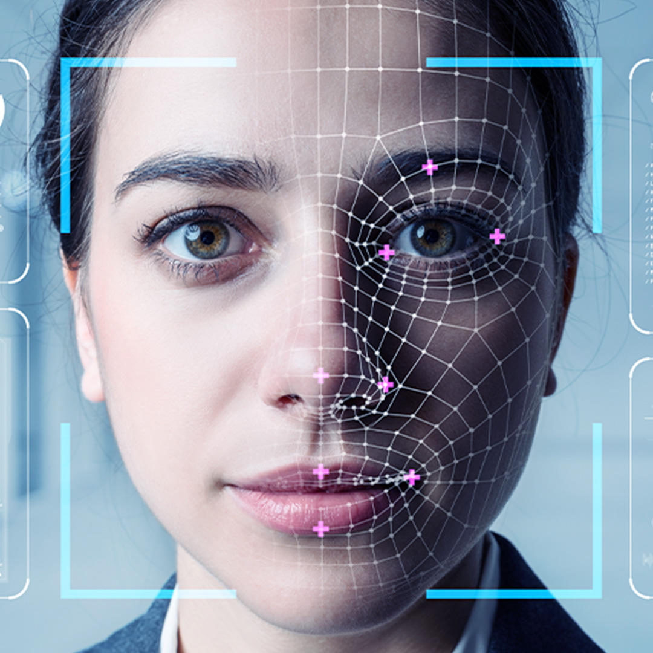
Face Detection Pipeline
The detection pipeline meticulously processes images to accurately locate faces, applying advanced algorithms for precision and quality.
Image Acquisition
Capture frames, then preprocess for clarity.
Detection Algorithms
Use Haar Cascades, MTCNN, or YOLO.
Bounding Box
Generate precise facial bounding boxes.
Quality Assessment
Filter detections for optimal quality.

Slide 5
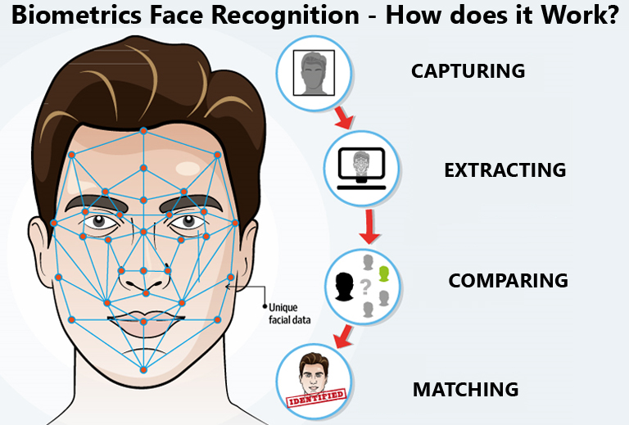
Face Recognition Pipeline
This pipeline transforms detected faces into verifiable identities, using deep learning for robust feature comparison.
1
Face Alignment
Normalize face orientation and scale.
2
Feature Extraction
Generate deep learning embeddings (e.g., FaceNet).
3
Database Comparison
Match embeddings against known identities.
4
Identity Classification
Assign identity with confidence scoring.

Slide 6



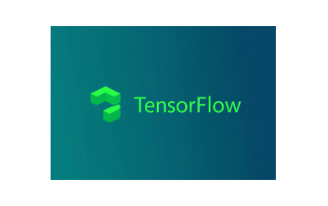





Technology Stack
Our robust technology stack leverages leading computer vision, deep learning, and programming tools to build high-performance systems.
From popular libraries like OpenCV to powerful frameworks such as TensorFlow and PyTorch, our choices ensure scalability and efficiency. We also optimise for both CPU and GPU acceleration.

Slide 7





Performance & Optimization
Real-time implementation faces challenges like maintaining high frame rates and balancing accuracy with speed. Effective resource management is also essential.
Speed Challenges
Accuracy Trade-offs
Optimise frame rate and minimise processing latency.
Balance precision with real-time performance.
Resource Management
Environmental Factors
Efficiently utilise CPU/GPU resources.
Address lighting, angles, and occlusions.

Slide 8

Future of Face Recognition Technology
The future promises enhanced accuracy and anti-spoofing, driven by 3D recognition and edge AI. Ethical considerations and data protection remain paramount.
Emerging Trends
3D face recognition, anti-spoofing, edge AI.
Privacy Considerations
Ethical AI development, robust data protection.
Performance Improvements
Enhanced real-time accuracy, low-power devices.
Key Takeaways
Benefits and ethical considerations are crucial.

